Slide 1

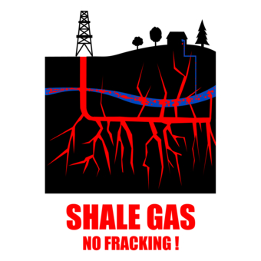
Peak Oil to Shale Gas
Rotary Crans-Montana 16/12/2013
Notes:
Talk about agenda wo showing slide
9 y ago peak today shale

Slide 2
Peak to Shale
Energies Fossiles
Convergence des energies fossiles
Importance vitale
Origines
Hydrocarbures non conventionels:
-Impact economique
-Impact ecologique
Previsions officielles, Alternatives vertes

Slide 3
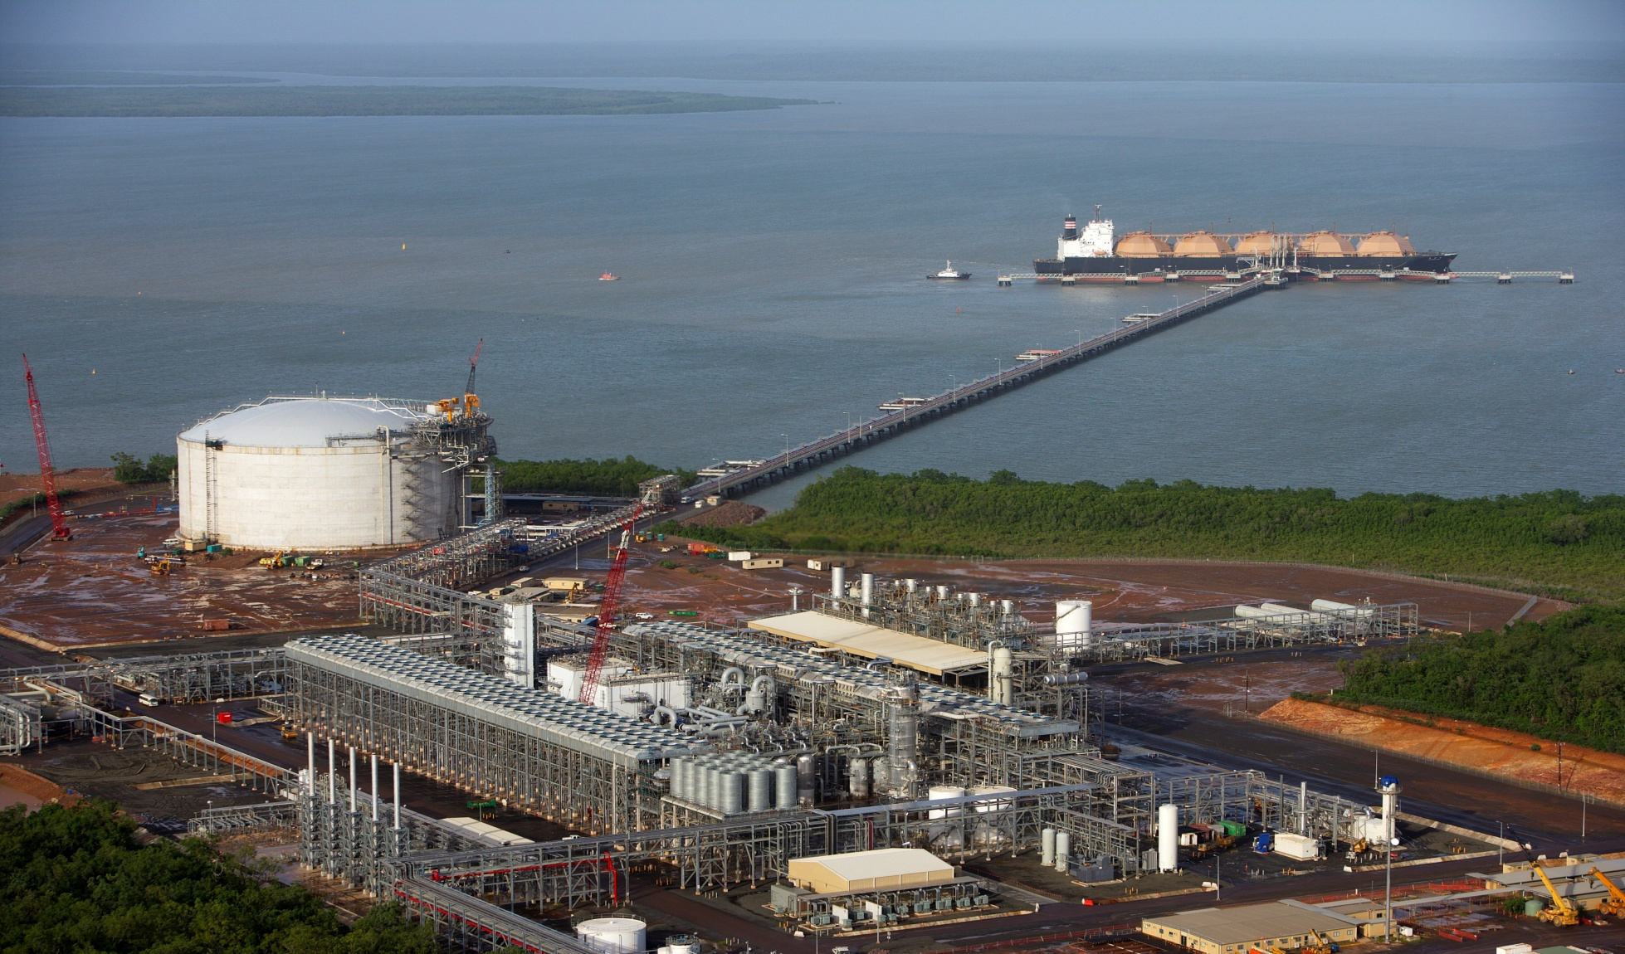
LNG Transport Infrastructure:
Liquefaction: 32/13 Tankers 400/70 Regasification:80/20
Notes:
300m long, -163 deg C, 150k m3, Energie 1 an ville 50K. CNG, LNG and gas into gasoline for vehicles: CNG 70% less energy intensive. LNG has to be liquified. Buses=60%CNG.

Slide 4
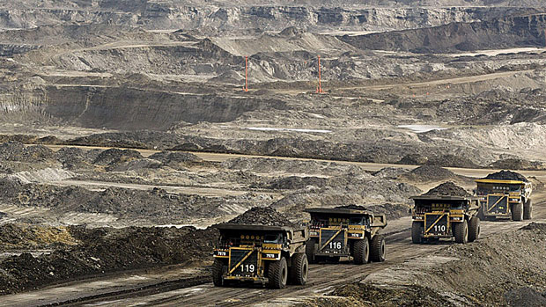
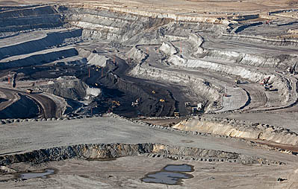
Oil Sands vs Coal

Slide 5
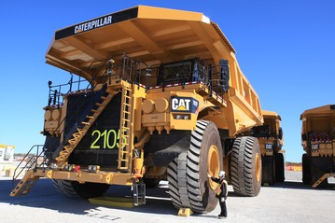

Slide 6
Importance du Pétrole
« Oil is Money »: Essence : 30 centimes/ L
« Oïl is Power »: WW1, WW2, US, US/Saudi…
« Oil is Quality of Life »: Lumière, Transport, Chauffage, Engrais, Plastiques, Chimie....
Tout notre système économique et la croissance sans précèdent du 20 siècle sont basés sur une source d’énergie concentré, transportable, stockable, inépuisable et pas chère
Par seconde 150T Pétrole, 25T Acier, 15T Blé, 12T Riz
Un de a coudre = un Homme
Suisse: Hydrocarbures 70%, Nucléaire 14%, Hydro 8%
Notes:
Don’t show

Slide 7
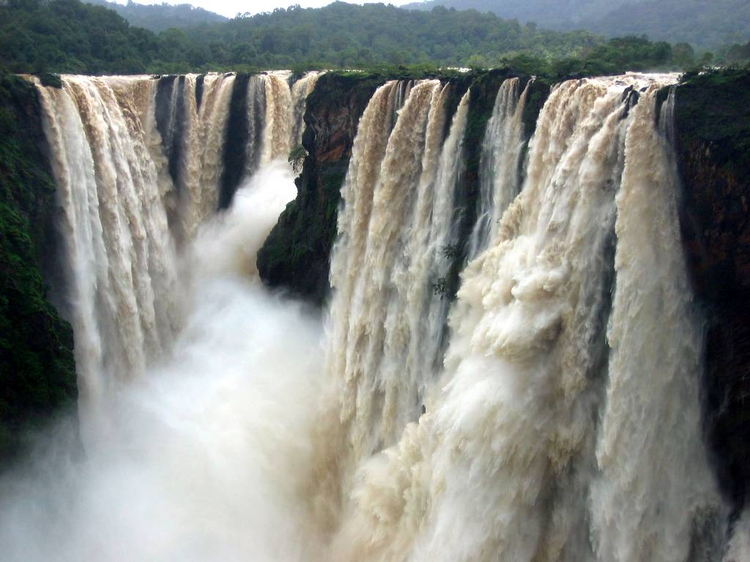
Oil Consumption
Notes:
30cts /litre

Slide 8

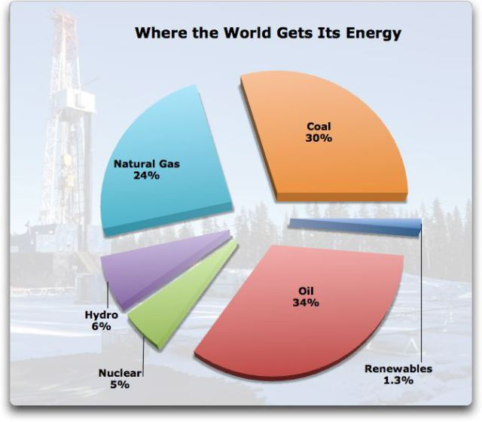



Notes:
Suisse Hydrocarbures 68% (70%), Nucleaire 14%, Hydro 8%

Slide 9
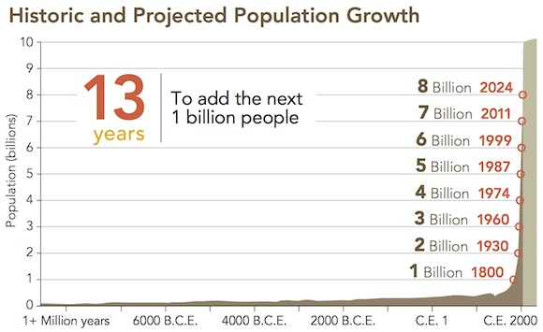

Notes:
700 millions since last presentation, 1974 2 billion below poverty, today only one: explosive economic growth 2b to 6b in 40 years
What will happen after fossil fuels? That is the question!

Slide 10
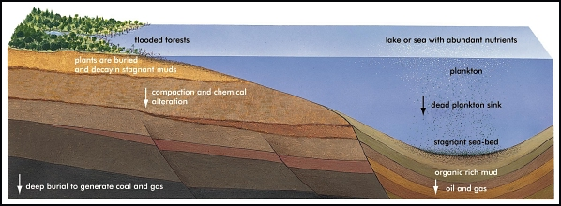
Origines des Energies Fossiles
Il y a 130 a 140 millions d’années!

Slide 11
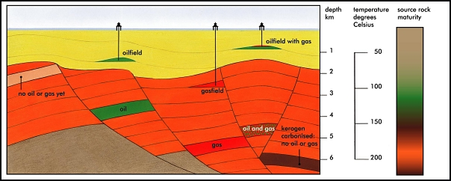
Les roches mères

Slide 12
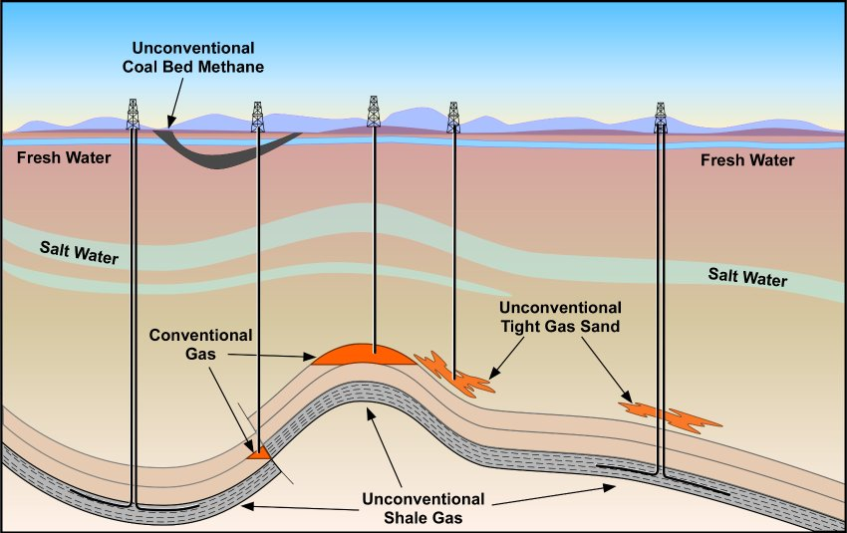
Unconventional Gas
Notes:
Add Oil sands and Gas Hydrates

Slide 13
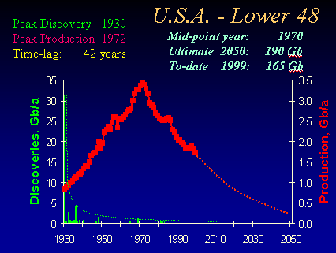

Slide 14
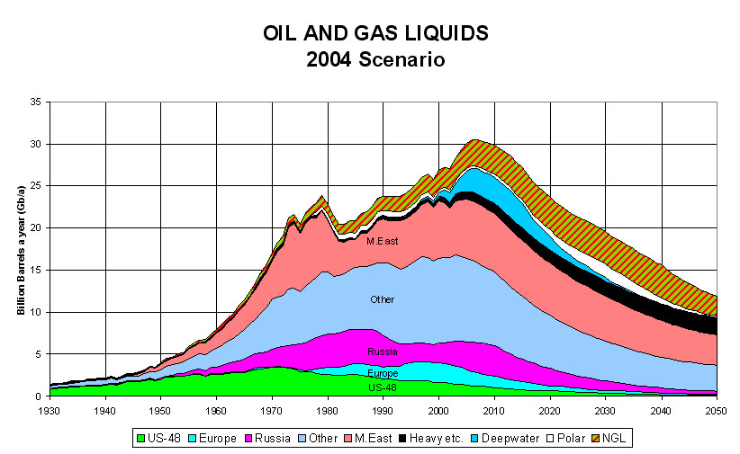

Slide 15
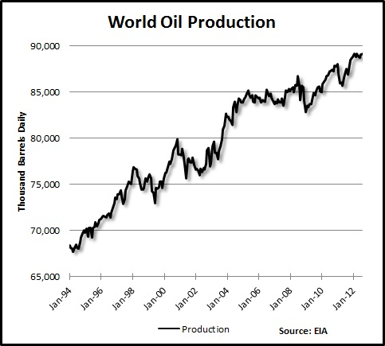

Slide 16
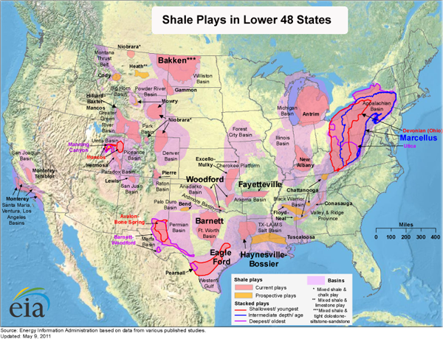

Slide 17
Causes of Shale Boom
Price x 5 due to Peak Conventional Hydrocarbons.
Existing Technologies optimized for Shale: Non exclusive 3D, Horizontal Drilling, Measurement while drilling, HiDensity completions, Multistage Fracking…
US Environment: Favorable geology, attractive mineral rights, public support, Nimble oil companies, experienced consultants and service industry, extensive infrastructure, political support, fiscal climate…. “Can do” attitude.

Slide 18
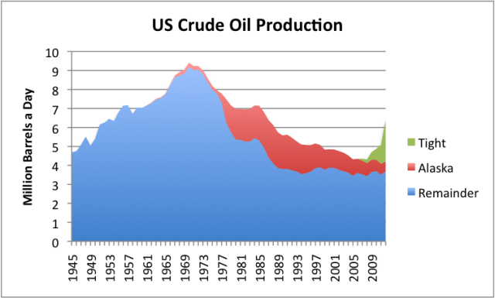

Slide 19
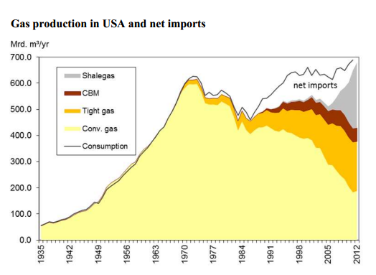

Slide 20
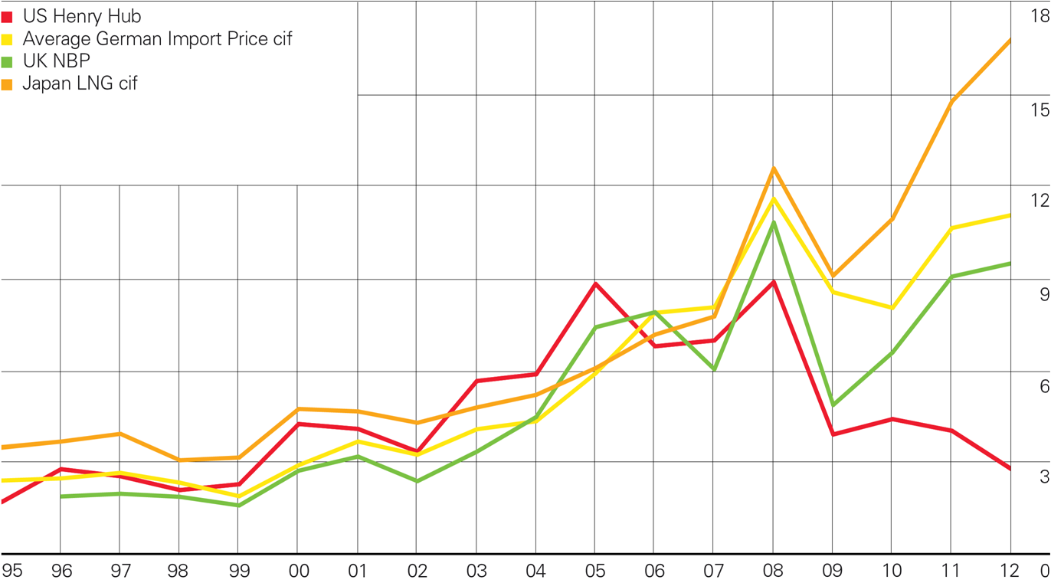

Slide 21
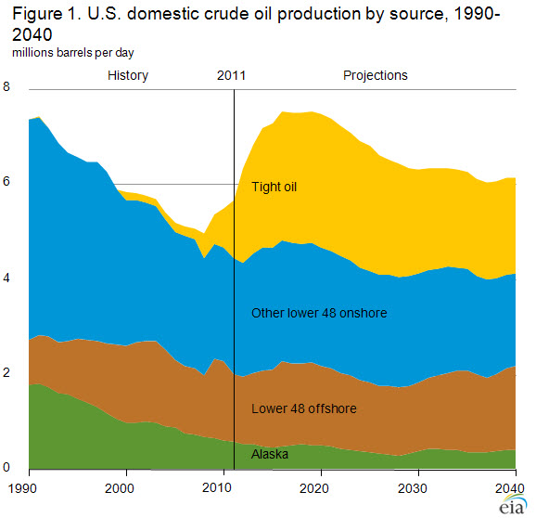

Slide 22
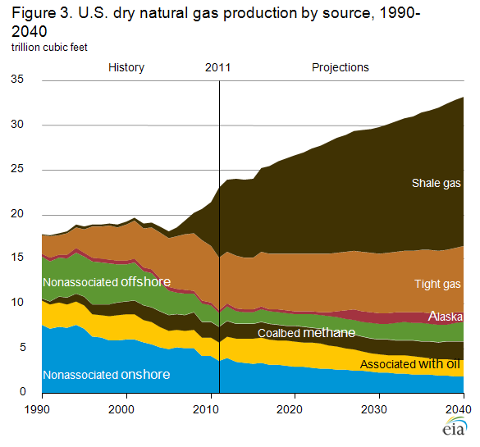

Slide 23
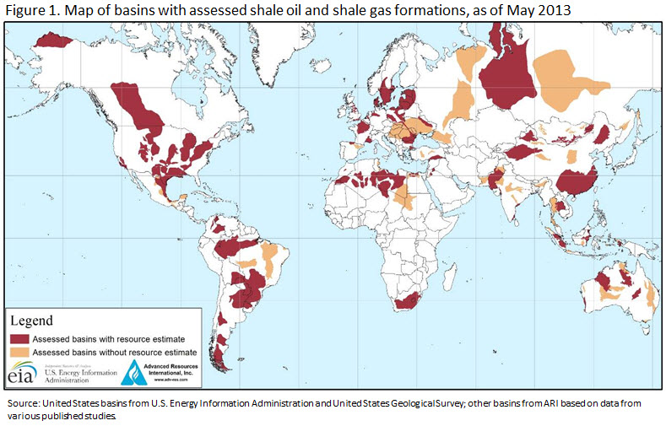

Slide 24
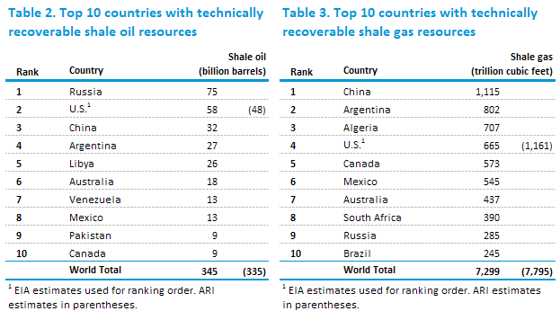

Slide 25
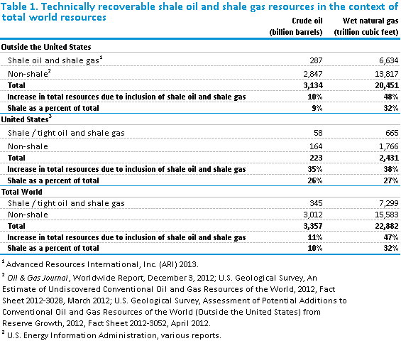

Slide 26
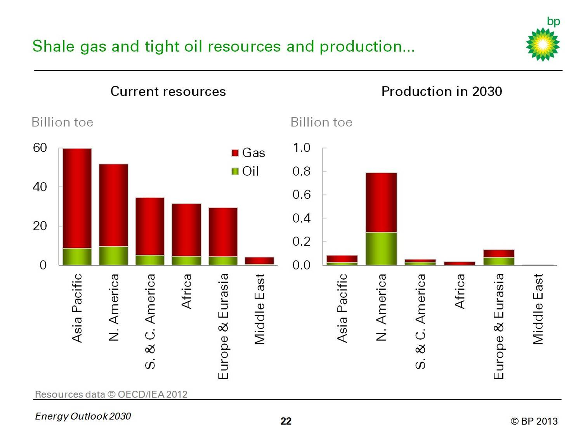

Slide 27
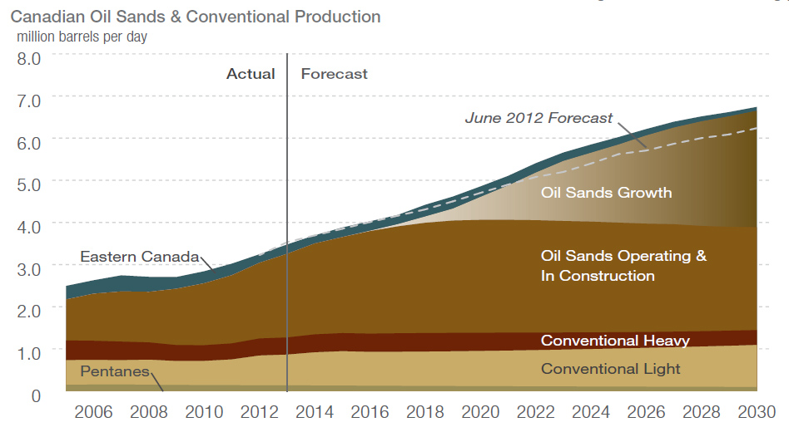
Notes:
1/3 world tar reserves, venezuela 1/3 . 2M3 terre, 2M3 sable, plusieurs barrels eau chaude = un barrel oil A 5 million barril jour cela devient titanesque

Slide 28
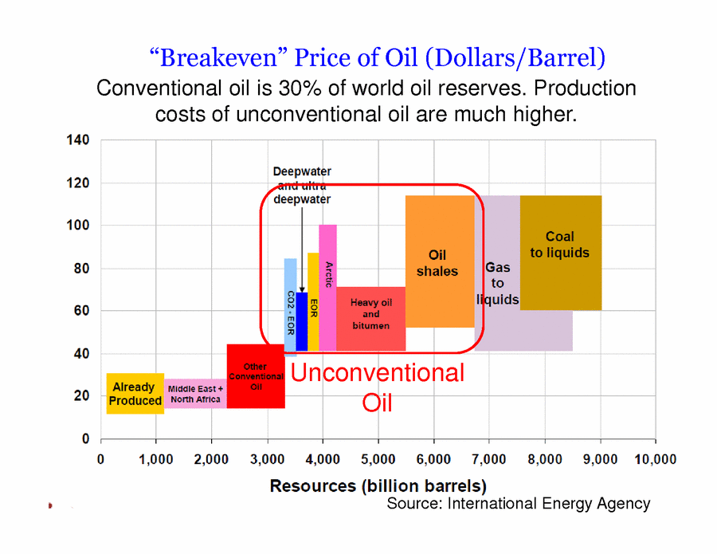
Notes:
No show

Slide 29
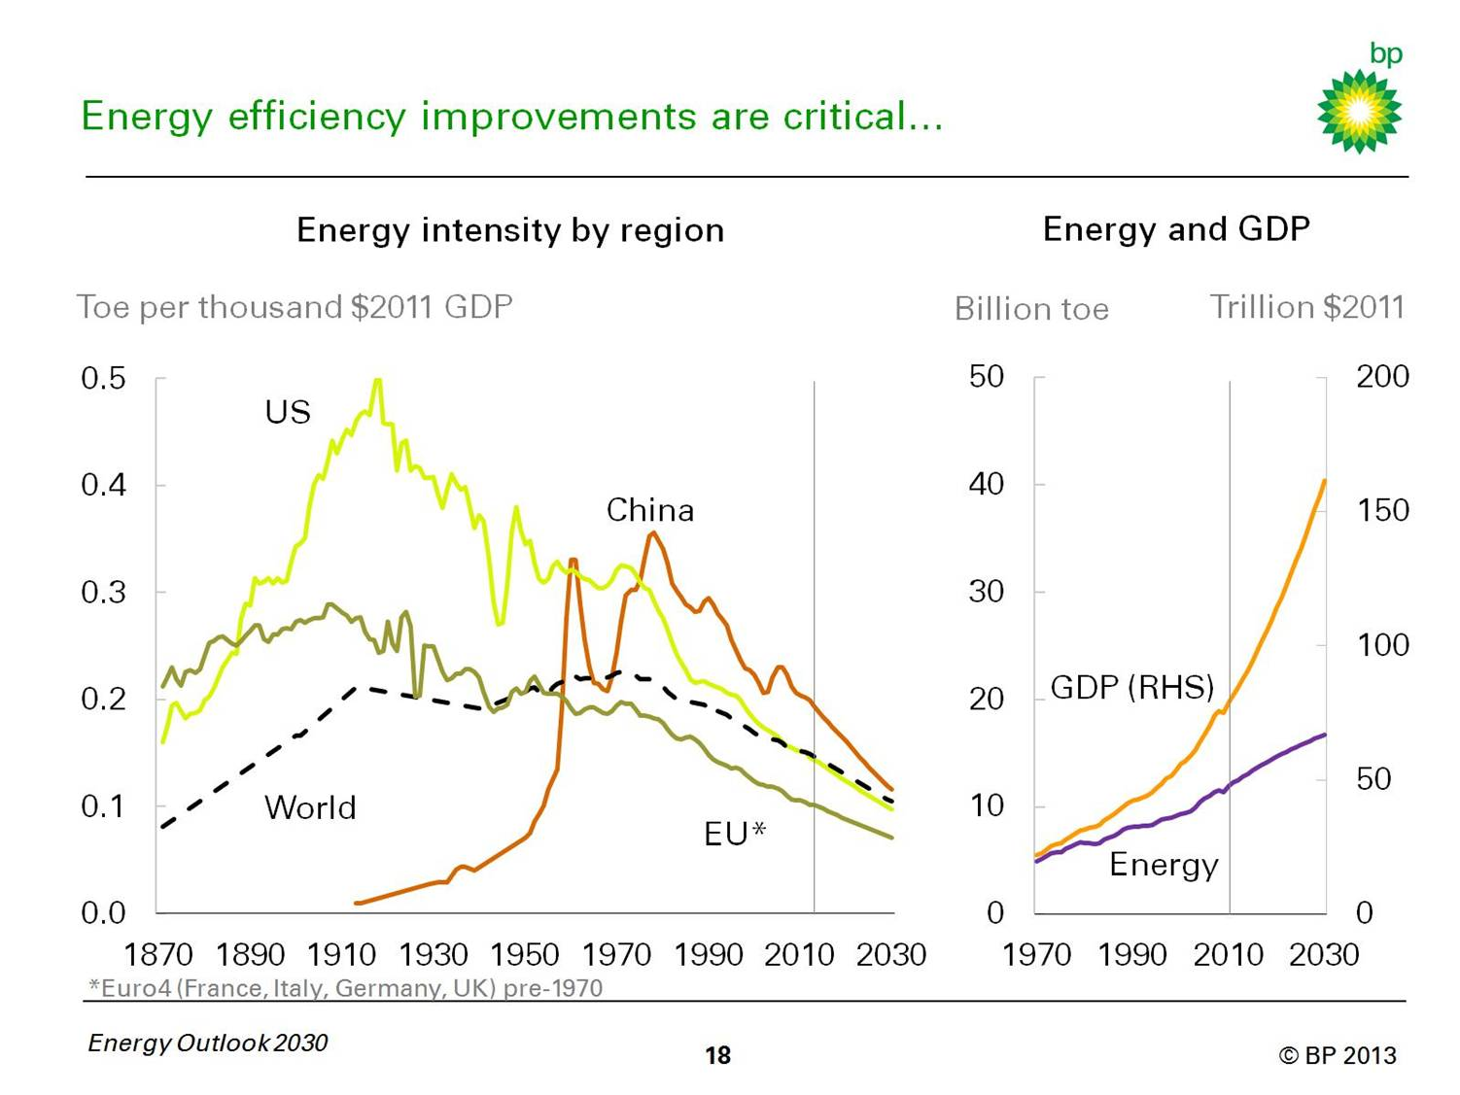

Slide 30
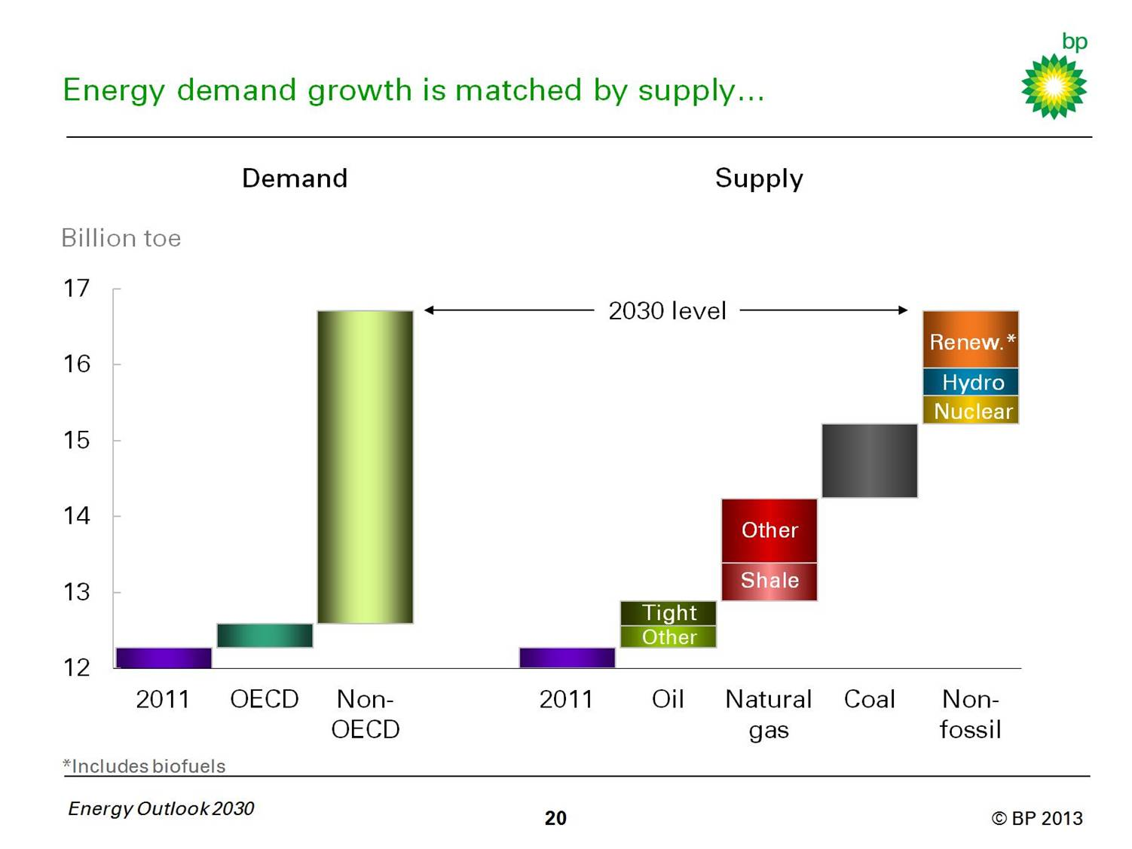
Notes:
Includes continue improvements in energy efficiency :US, China…

Slide 31
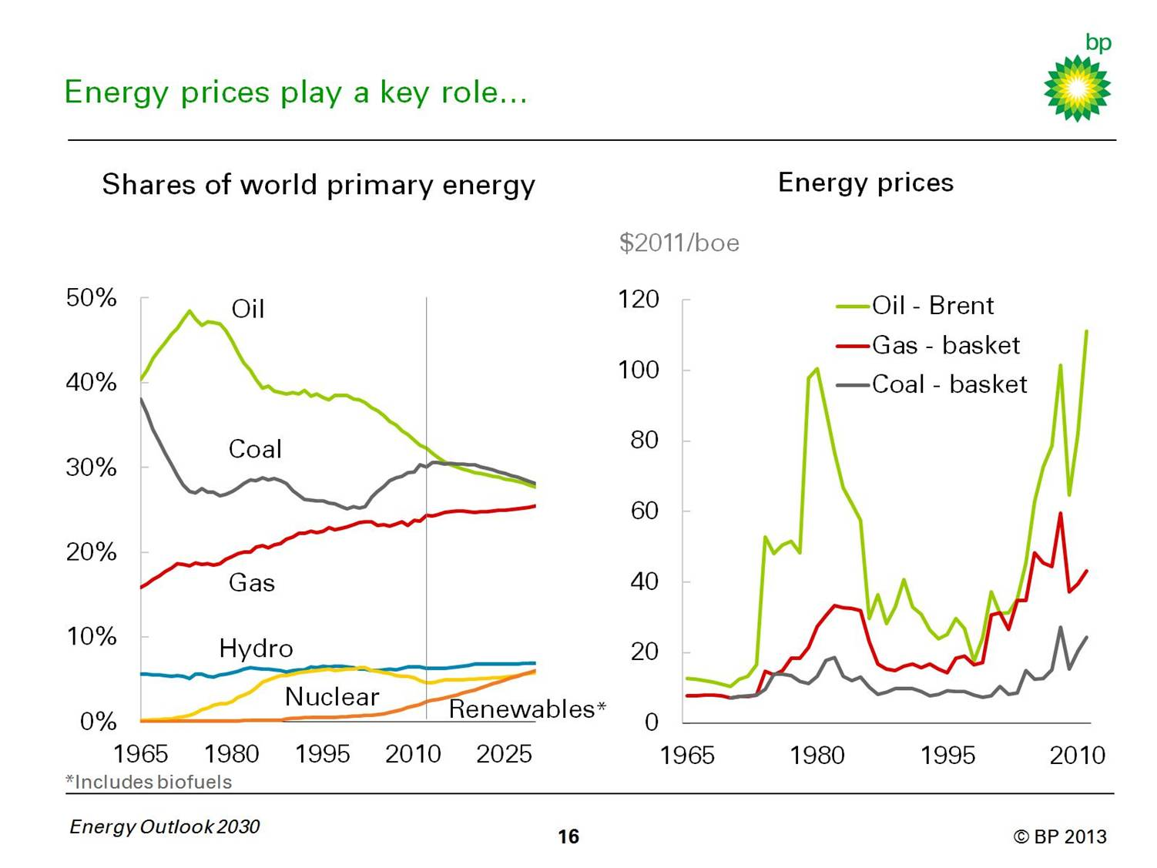

Slide 32
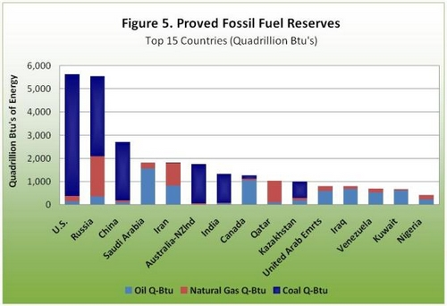
Notes:
50 years oil and gas, 100 years coal. With ressources possibly more, But more expensive, less energy efficient.

Slide 33
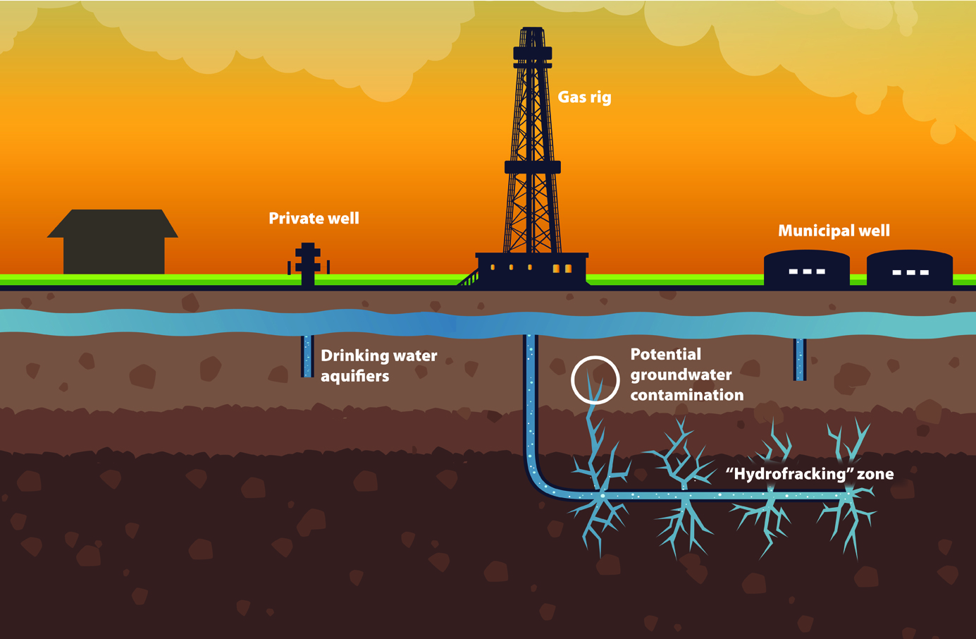
Stop fracking!

Slide 34
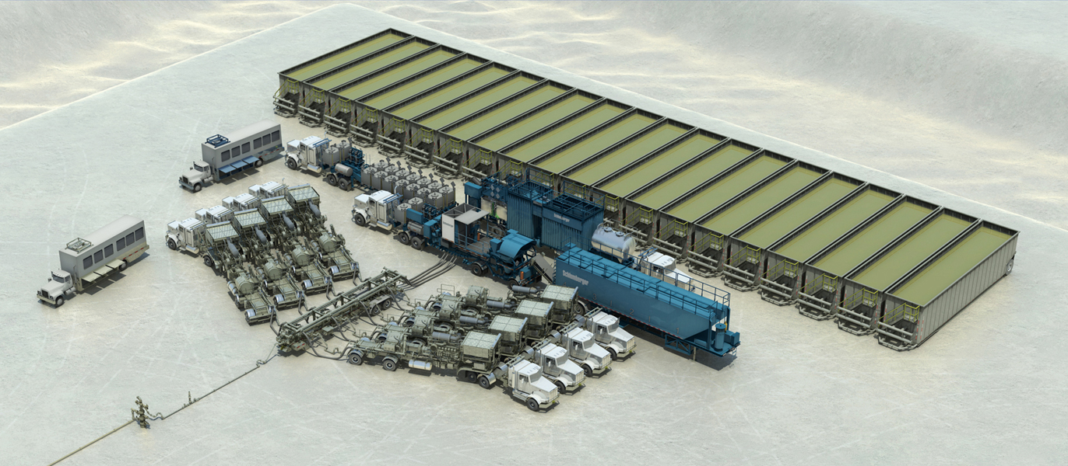
Schlumberger Frac Job
Notes:
What is a Frac job? 1 million fracs WW in last 60 years!

Slide 35
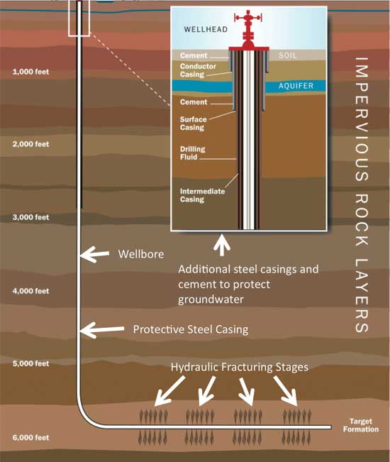

Slide 36
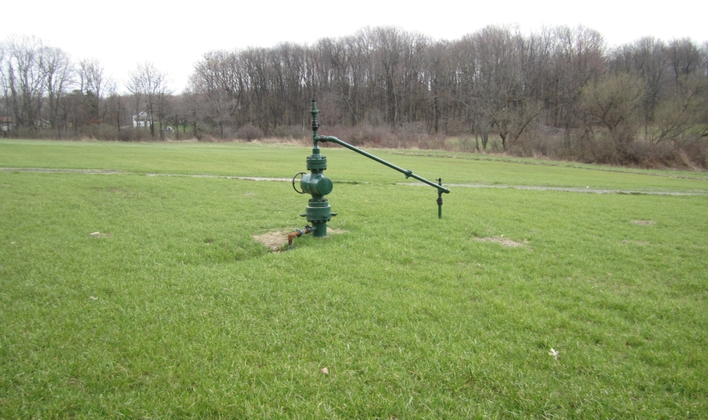
Marcellus shale gas producing well

Slide 37
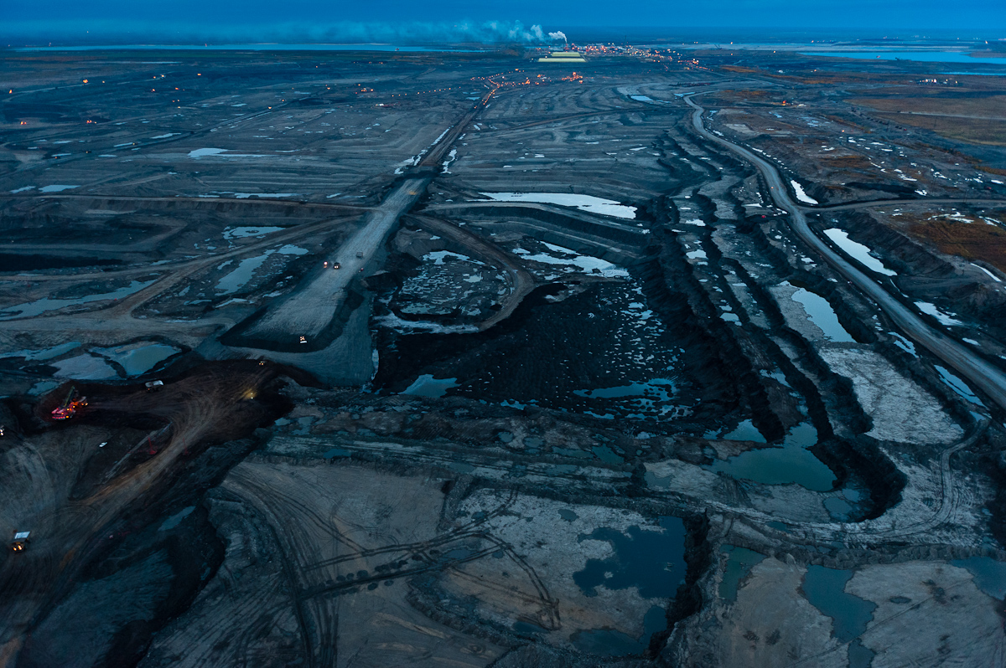
Notes:
Sables bitumineux, goudron: Pb: Water consumption, land reclamation, energy efficiency, air emissions: Total area 140K km2= England
2/3 already leased! 80 percent In situ production

Slide 38
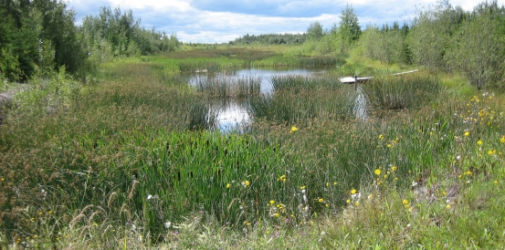

Slide 39
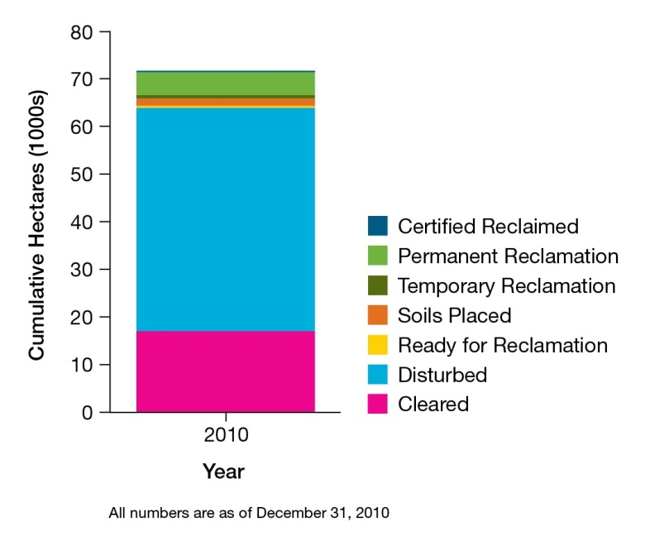
Notes:
Pour 1 million barril jour. Equals 10 good mea wells.

Slide 40
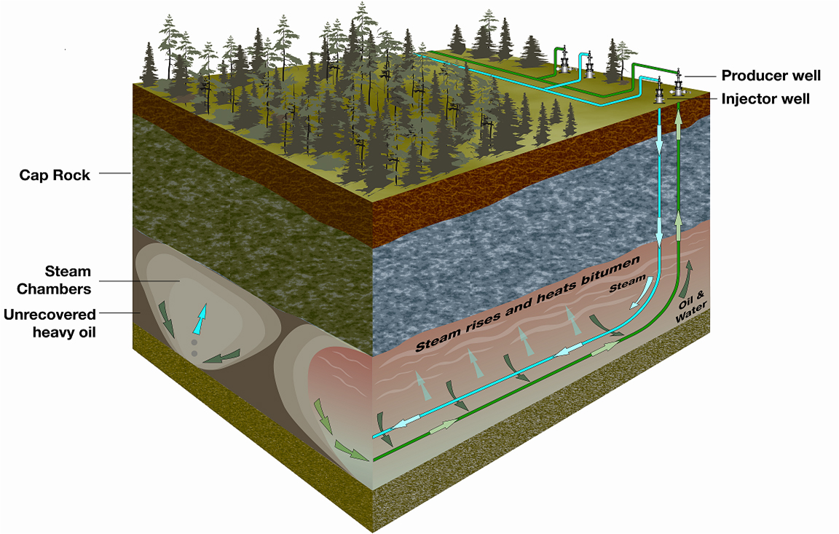
Notes:
5m interval, energy efficiency 1-3 to 1-2, ethanol 1-2 , recovery 60%,

Slide 41
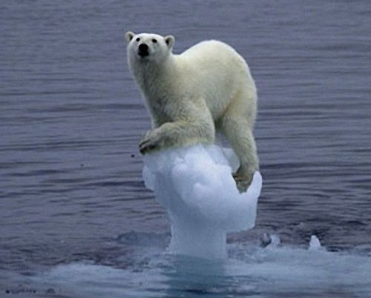
Let’s talk about Global Warming!

Slide 42
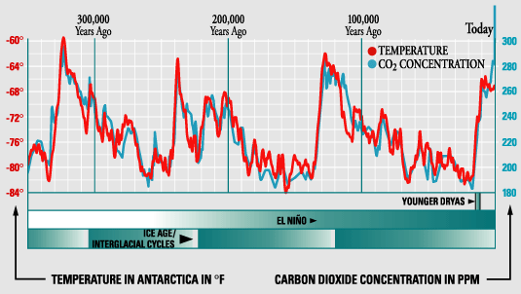
Notes:
Ice age started 2.6 Million years ago.

Slide 43
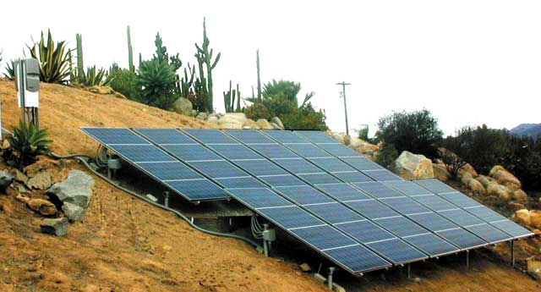
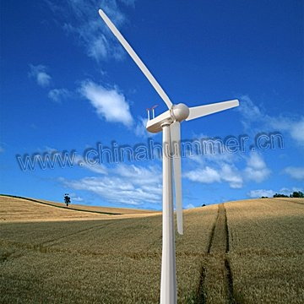
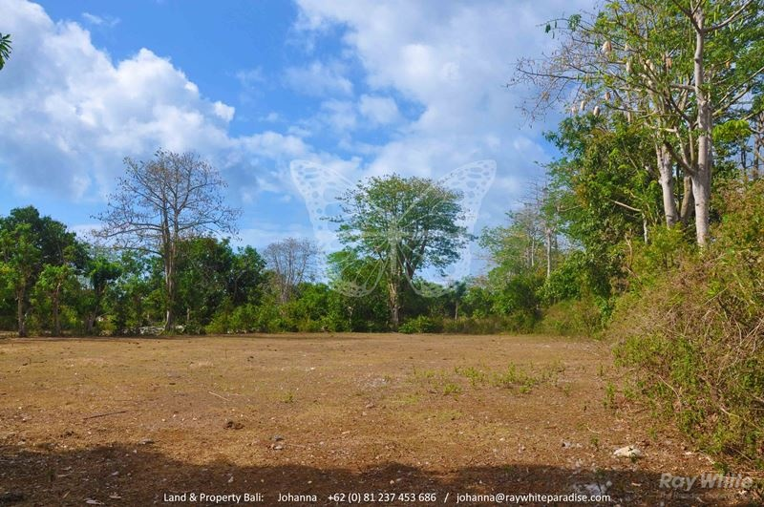
Replacing fossil fuels: 40,000 kwh/year/capita
Green solution:
150m2 solar, 10kw wind turbine, 1.3 hectares corn ethanol
Realistic solution?
Bio fuel out, nuclear in, bigger turbines..
Notes:
(20kw solar, 5000 liters ethanol) , 7-8 m diametre, (world/capita: 1.7 H land 0,6 H agricultural, 0.2H arable) (Suisse: 0.5, 0.2, 500m2) (world solar 3% agri land, wind 100 M 1GW = 3/km2 agri land., one every 500m….) 3% Suisse, 1 eolienne 100m, 38 muhleberg, 5 en valais

Slide 44
13 TW 100% Renewable Energy
Stanford Professor Environmental Engineering
4 million, 5-Megawatt off and onshore wind turbines;
60K 300-Megawatt concentrated solar power plants;
50K 300-Megawatt solar photovoltaic power plants;
2 billion, 3-Kilowatt rooftop photovoltaic systems;
6K 100 Megawatt geothermal power plants;
300 new 1,300 Megawatt hydroelectric power plants;
800K 0.75 Megawatt wave energy devices;
500K one Megawatt tidal turbines.
Would use 1% earth (or 4% land or 12% Agriculture or 40% Arable)
Notes:
+50% hydro, yellow intermittent

Slide 45
Notes:
Nous= Generation benie

